Slide 1

Memory Networks
Jason Weston, Sumit Chopra and Antoine Bordes
Presenter: Jiasen Lu

Slide 2
Weston, Jason, Sumit Chopra, and Antoine Bordes. "Memory networks." arXiv preprint arXiv:1410.3916 (2014).
Weston, Jason, et al. "Towards AI-complete question answering: a set of prerequisite toy tasks." arXiv preprint arXiv:1502.05698 (2015).
Sainbayar Sukhbaatar. “End-To-End Memory Network” arXiv (2015)
Antoine Bordes, et al. “Large-scale Simple Question Answering with Memory Networks” arXiv(2015)

Slide 3
Memory Networks
Class of models that combine large memory with learning component that can read and write to it.
Most ML has limited memory which is more-or-less all that’s needed for “low level” tasks e.g. object detection.
Motivation: long-term memory is required to read a story (or watch a movie) and then e.g. answer questions about it.
We study this by building a simple simulation to generate ``stories’’. We also try on some real QA data
Slide credit: Jason Weston

Slide 4
MCTest comprehension data (Richardson et al.)
James the Turtle was always getting in trouble. Sometimes he'd reach into
the freezer and empty out all the food. Other times he'd sled on the deck
and get a splinter. His aunt Jane tried as hard as she could to keep him out
of trouble, but he was sneaky and got into lots of trouble behind her back.
One day, James thought he would go into town and see what kind of trouble
he could get into. He went to the grocery store and pulled all the pudding off
the shelves and ate two jars. Then he walked to the fast food restaurant and
ordered 15 bags of fries. He didn't pay, and instead headed home.
His aunt was waiting for him in his room. She told James that she loved
him, but he would have to start acting like a well-behaved turtle.
After about a month, and after getting into lots of trouble, James finally
made up his mind to be a better turtle.
Q: What did James pull off of the shelves in the grocery store?
A) pudding B) fries C) food D) splinters
…
Slide credit: Jason Weston

Slide 5
MCTest comprehension data (Richardson et al.)
James the Turtle was always getting in trouble. Sometimes he'd reach into
the freezer and empty out all the food. Other times he'd sled on the deck
and get a splinter. His aunt Jane tried as hard as she could to keep him out
of trouble, but he was sneaky and got into lots of trouble behind her back.
Problems: … it’s hard for this data to lead us to design good ML models …
Not enough data to train on (660 stories total). What ends up happening ordered 15 bags of fries. He didn't pay, and instead headed home.
If we get something wrong we don’t really understand why: every question potentially involves a different kind of reasoning, our model has to do a lot of different things.
Our solution: focus on simpler (toy) subtasks where we can generate data to check what the models we design can and cannot do.
One day, James thought he would go into town and see what kind of trouble
he could get into. He went to the grocery store and pulled all the pudding off
the shelves and ate two jars. Then he walked to the fast food restaurant and
ordered 15 bags of fries. He didn't pay, and instead headed home.
His aunt was waiting for him in his room. She told James that she loved
him, but he would have to start acting like a well-behaved turtle.
After about a month, and after getting into lots of trouble, James finally
made up his mind to be a better turtle.
Q: What did James pull off of the shelves in the grocery store?
A) pudding B) fries C) food D) splinters
Q: Where did James go after he went to the grocery store?
…
Slide credit: Jason Weston

Slide 6
Example
Dataset in simulation command format. Dataset after adding a simple grammar.
antoine go kitchen
antoine get milk
antoine go office
antoine drop milk
antoine go bathroom
where is milk ? (A: office)
where is antoine ? (A: bathroom)
Antoine went to the kitchen.
Antoine picked up the milk.
Antoine travelled to the office.
Antoine left the milk there.
Antoine went to the bathroom.
Where is the milk now? (A: office)
Where is Antoine? (A: bathroom)
Slide credit: Jason Weston

Slide 7
Simulation Data Generation
Aim: built a simple simulation which behaves much like a classic text adventure game. The idea is that generating text within this simulation allows us to ground the language used.
Actions:
go <location>, get <object>, get <object1> from <object2>,
put <object1> in/on <object2>, give <object> to <actor>,
drop <object>, look, inventory, examine <object>.
Constraints on actions:
an actor cannot get something that they or someone else already has
they cannot go to a place they are already at
cannot drop something they do not already have
…
Slide credit: Jason Weston
Notes:
----- Meeting Notes (10/27/15 16:32) -----
khj

Slide 8
(1) Factoid QA with Single Supporting Fact
John is in the playground.
Bob is in the office.
Where is John? A:playground
(2) Factoid QA with Two Supporting Facts
John is in the playground.
Bob is in the office.
John picked up the football.
Bob went to the kitchen.
Where is the football? A:playground
Where was Bob before the kitchen? A:office
… (total 20 Tasks)
Slide credit: Jason Weston

Slide 9
Memory Networks
MemNNs have four component networks (which may or may not have shared parameters):
I: (input feature map) this converts incoming data to the internal feature representation.
G: (generalization) this updates memories given new input.
O: this produces new output (in feature representation space) given the memories.
R: (response) converts output O into a response seen by the outside world.
This process is applied both train and test time, only difference is model parameter I, G, O and R are not update during test time.
Slide credit: Jason Weston

Slide 10
Basic Model
I: (input feature map) no conversion, keep original text x.
G: (generalization) stores I(x) in next available slot m_{N}
O: Loops over all memories k=1 or 2 times:
1st loop max: finds best match m_{i} with x.
2nd loop max: finds best match m_{J} with (x, m_{i}).
The output o is represented with (x, mi, m_{J}).
R: (response) ranks all words in the dictionary given o and returns best single word. (OR: use a full RNN here)
RNN: [x, o1, o2,…, r] feed into RNN, Test time: [x, o1, o2,…]
Slide credit: Jason Weston

Slide 11
Matching function
For a given Q, we want a good match to the relevant memory slot(s) containing the answer, e.g.:
Match (Where is the football ?, John picked up the football)
We use a q^{T}U^{T}Ud embedding model with word embedding features.
LHS features: Q:Where Q:is Q:the Q:football Q:?
RHS features: D:John D:picked D:up D:the D:football
QDMatch:the QDMatch:football
(QDMatch:football is a feature to say there’s a Q&A word match, which can help.)
The parameters U are trained with a margin ranking loss:
supporting facts should score higher than non-supporting facts.
Slide credit: Jason Weston

Slide 12
Matching function: 2nd hop
On the 2nd hop we match question & 1st hop to new fact:
Match( [Where is the football ?, John picked up the football],
John is in the playground)
We use the same q^{T}U^{T}Ud embedding model:
LHS features: Q:Where Q:is Q:the Q:football Q:? Q2: John Q2:picked Q2:up Q2:the Q2:football
RHS features: D:John D:is D:in D:the D:playground QDMatch:the QDMatch:is ..Q2DMatch:John
We also need time information for bAbI simulation.
We tried adding absolute time differences (between two memories) as a feature: tricky to get to work.
Slide credit: Jason Weston

Slide 13
Some Extensions
Some options and extensions:
Efficient Memory Via Hashing
Hashing word
Memory will be considered if only share at least one word
Clustering word embedding
Run K-means to cluster word vectors U, given K buckets
Hash a given sentence into all the buckets that it’s individual words fells into.
Modeling Previous Unseen words
Store bag of words it has co-occurred with.
Increase the feature representation D from 3|W| to 5 |W|
Using kind of the dropout technique.
Slide credit: Jason Weston

Slide 14
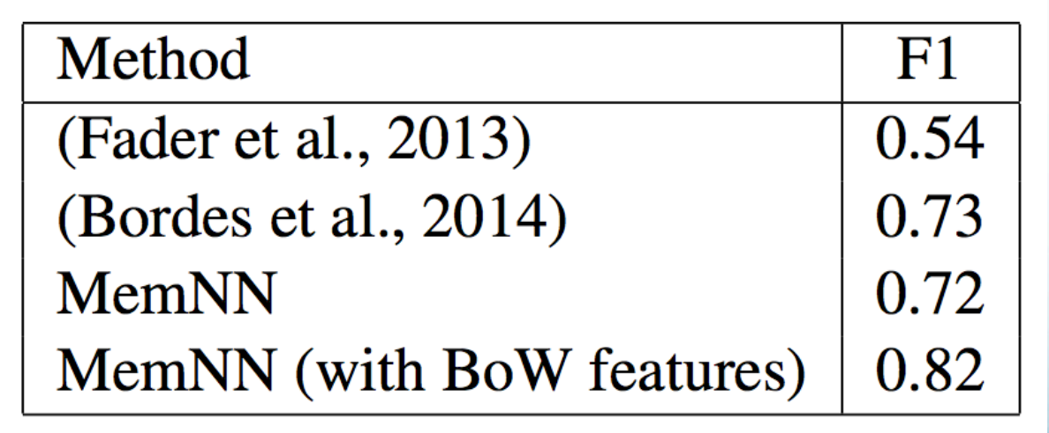
Results: QA on Reverb data
from (Fader et al.)
14M statements stored in the memNN memory.
k=1 loops MemNN, 128-dim embedding.
R response simply outputs top scoring statement.
Time features are not necessary, hence not used.
We also tried adding bag of words (BoW) features.
Slide credit: Jason Weston

Slide 15
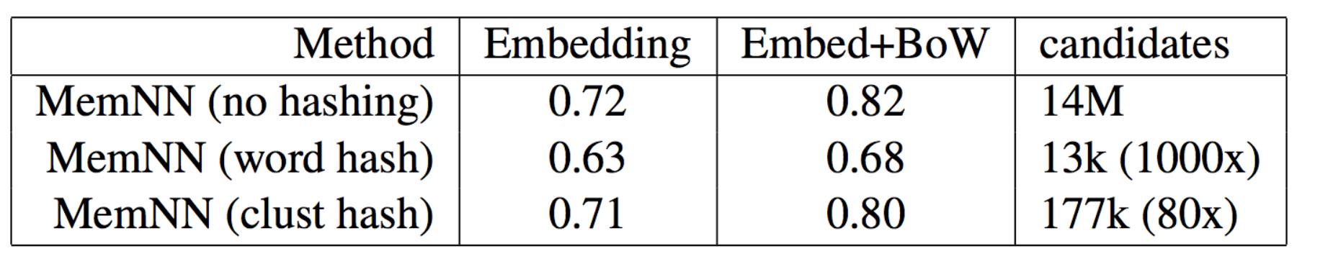
Results: QA on Reverb data
from (Fader et al.)
Scoring all 14M candidates in the memory is slow.
We consider speedups using hashing in S and O as
mentioned earlier:
Hashing via words (essentially: inverted index)
Hashing via k-means in embedding space (k=1000)
Slide credit: Jason Weston

Slide 16
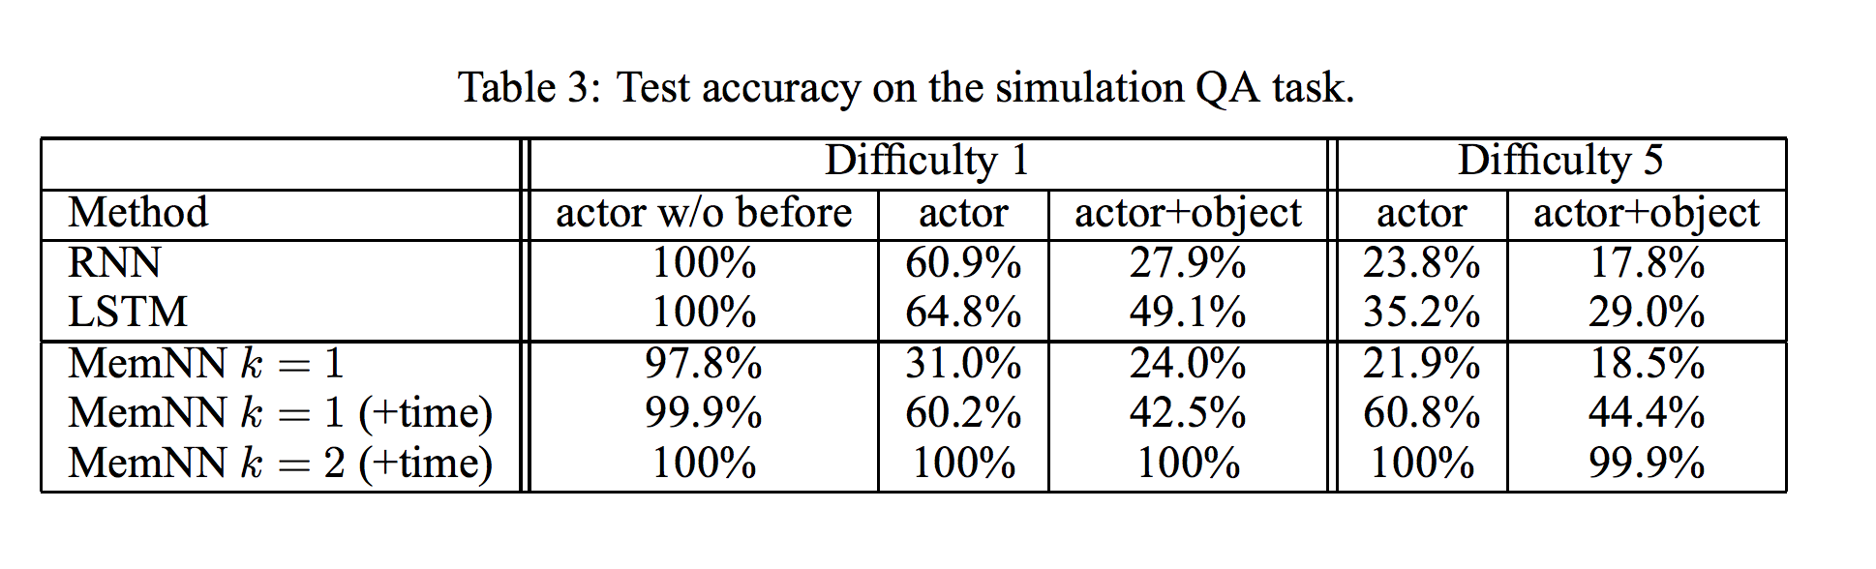
bAbI Experiment
10k sentences. (Actor: only ask questions about actors.)
• Difficulty: how many sentences in the past when entity mentioned.
• Fully supervised (supporting sentences are labeled).
• Compare RNN (no supervision)
and MemNN hops k = 1 or 2, & with/without time features.
Slide credit: Jason Weston

Slide 17
Shortcomings of Existing Model
They model sentences with a bag of words so are likely to fail on tasks such as the 2-argument and 3-argument relation problems.
They perform only two max operations (k = 2) so they cannot handle questions involving more than two supporting facts
Unless a RNN is employed in the R module, they are unable to provide multiple answers in the standard setting. This is required for the list (3.8) and path finding (3.19) tasks.
Slide credit: Towards AI-complete question answering: a set of prerequisite toy tasks

Slide 18
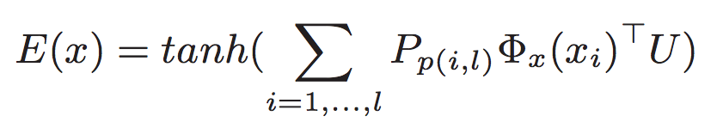
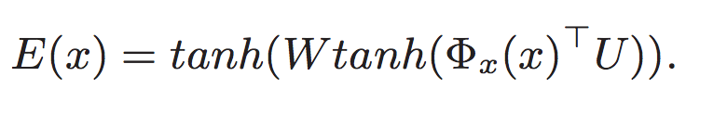
Improving Memory Networks
ADAPTIVE MEMORIES (AND RESPONSES)
Add a Special fact m* (like end token) (AM)
Add a Special word w* (same)
NONLINEAR SENTENCE MODELING
a bag-of-N-grams (NG)
multilinear map (ML)
non-linear embedding (NL)
Slide credit: Towards AI-complete question answering: a set of prerequisite toy tasks

Slide 19
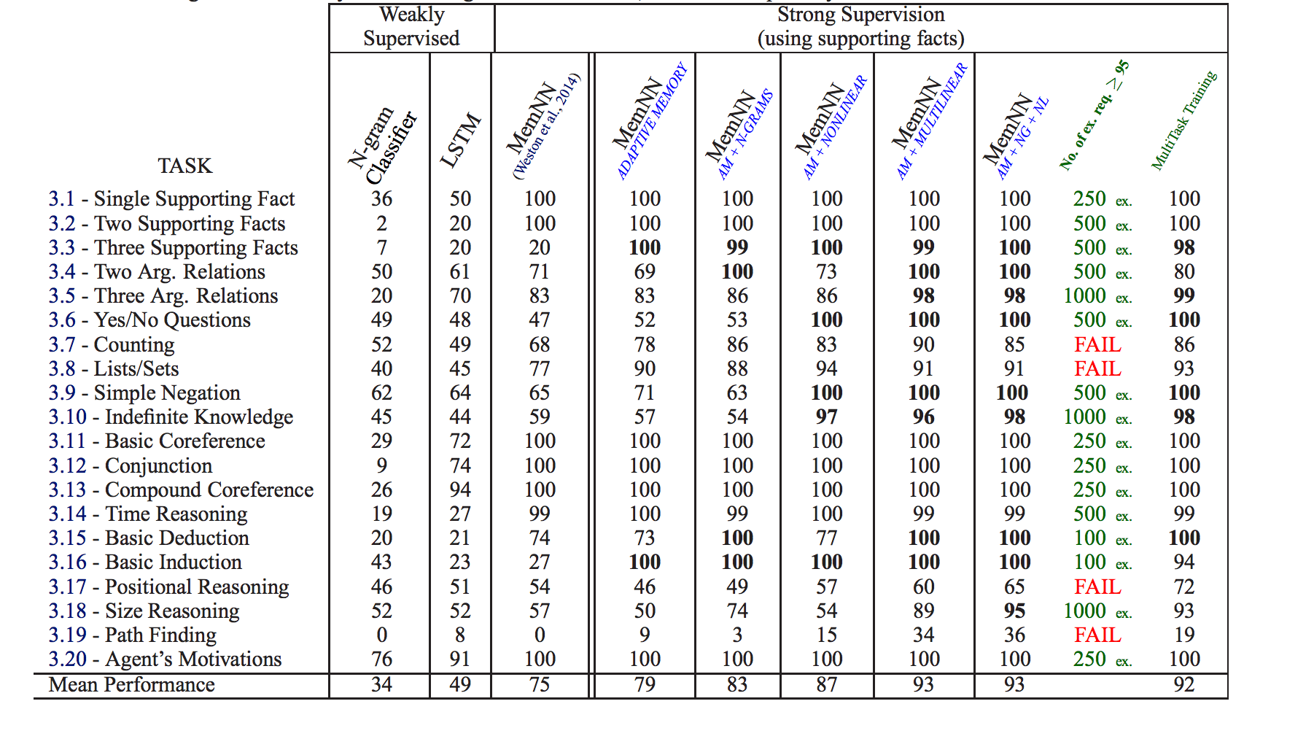
image credit: Towards AI-complete question answering: a set of prerequisite toy tasks

Slide 20
Failing Tasks
3.17. Positional Reasoning
The triangle is to the right of the blue square.
The red square is on top of the blue square.
The red sphere is to the right of the blue square.
Is the red sphere to the right of the blue square? A:yes
Is the red square to the left of the triangle? A:yes
3.19. Path Finding
The kitchen is north of the hallway.
The den is east of the hallway.
How do you go from den to kitchen? A: west, north
Slide credit: Jason Weston

Slide 21
Failing Tasks
3.7. Counting
Daniel picked up the football.
Daniel dropped the football.
Daniel got the milk.
Daniel took the apple.
How many objects is Daniel holding? A: two
3.8. Lists / Sets
Daniel picks up the football.
Daniel drops the newspaper.
Daniel picks up the milk.
What is Daniel holding? milk, football
Slide credit: Jason Weston

Slide 22
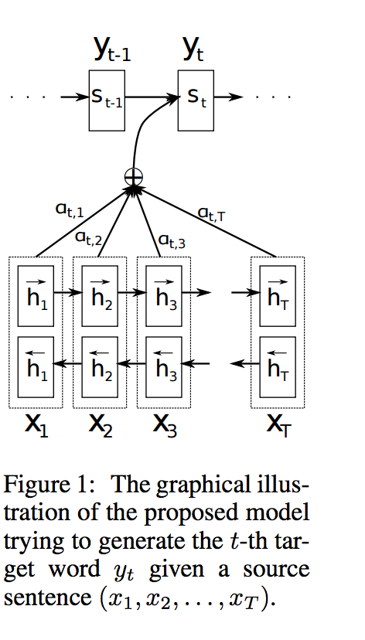
End-to-end Memory networks
Problem of Memory Network:
not easy to train via back propagation
required supervision at each layer of the network.
Continuous form of memory network
Attention paper:
RNN search:
Show attend and tell:
Image credit: RNN search paper

Slide 23
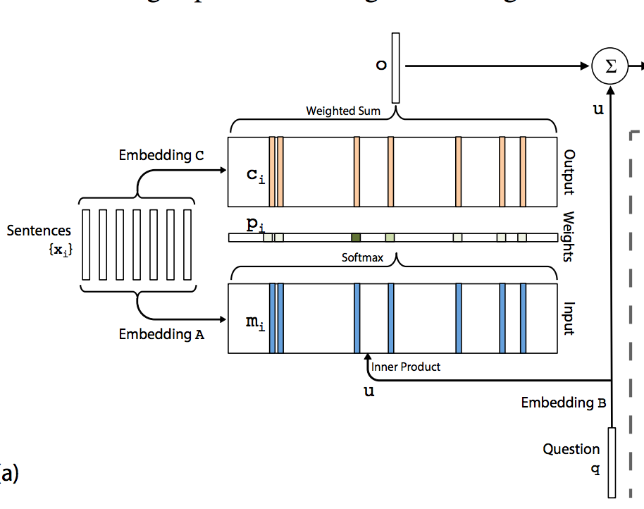
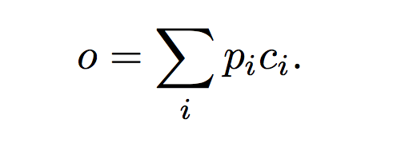
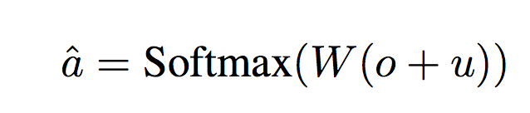
Model-single layer
Embedding Parameter: A, B, C, W
Input memory representation
p_{i} = Softmax(u^{T}m_{i})
Output memory representation
Generating the final prediction
Memory size 50
Slide credit: Reference paper

Slide 24
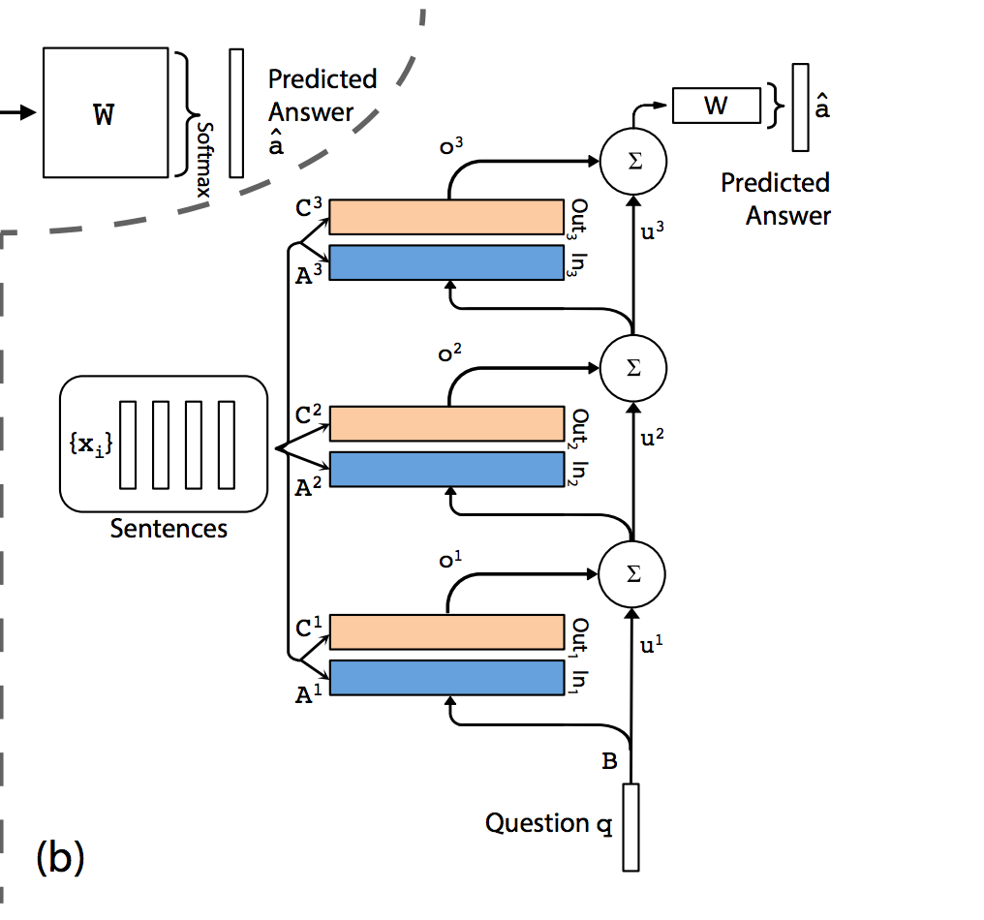
Model-multiple layers
Weight type
1: Adjacent:
A^{k+1} = C^{k}
W^{T} = C^{K} (final output embedding)
B = A¹
2: Layer-Wise
A¹ = A² = …
u^{k+1} = Hu^{k} + o^{k}
Slide credit: Reference paper

Slide 25
Some extensions
Sentence Representation (PE)
Temporal Encoding
Inject Random noise (RN)
random add 10% of the empty memories
Linear Start(LS)
initial train with remove all the non-linear without softmax
:Special matrix encode temporal info
Slide credit: Reference paper

Slide 26
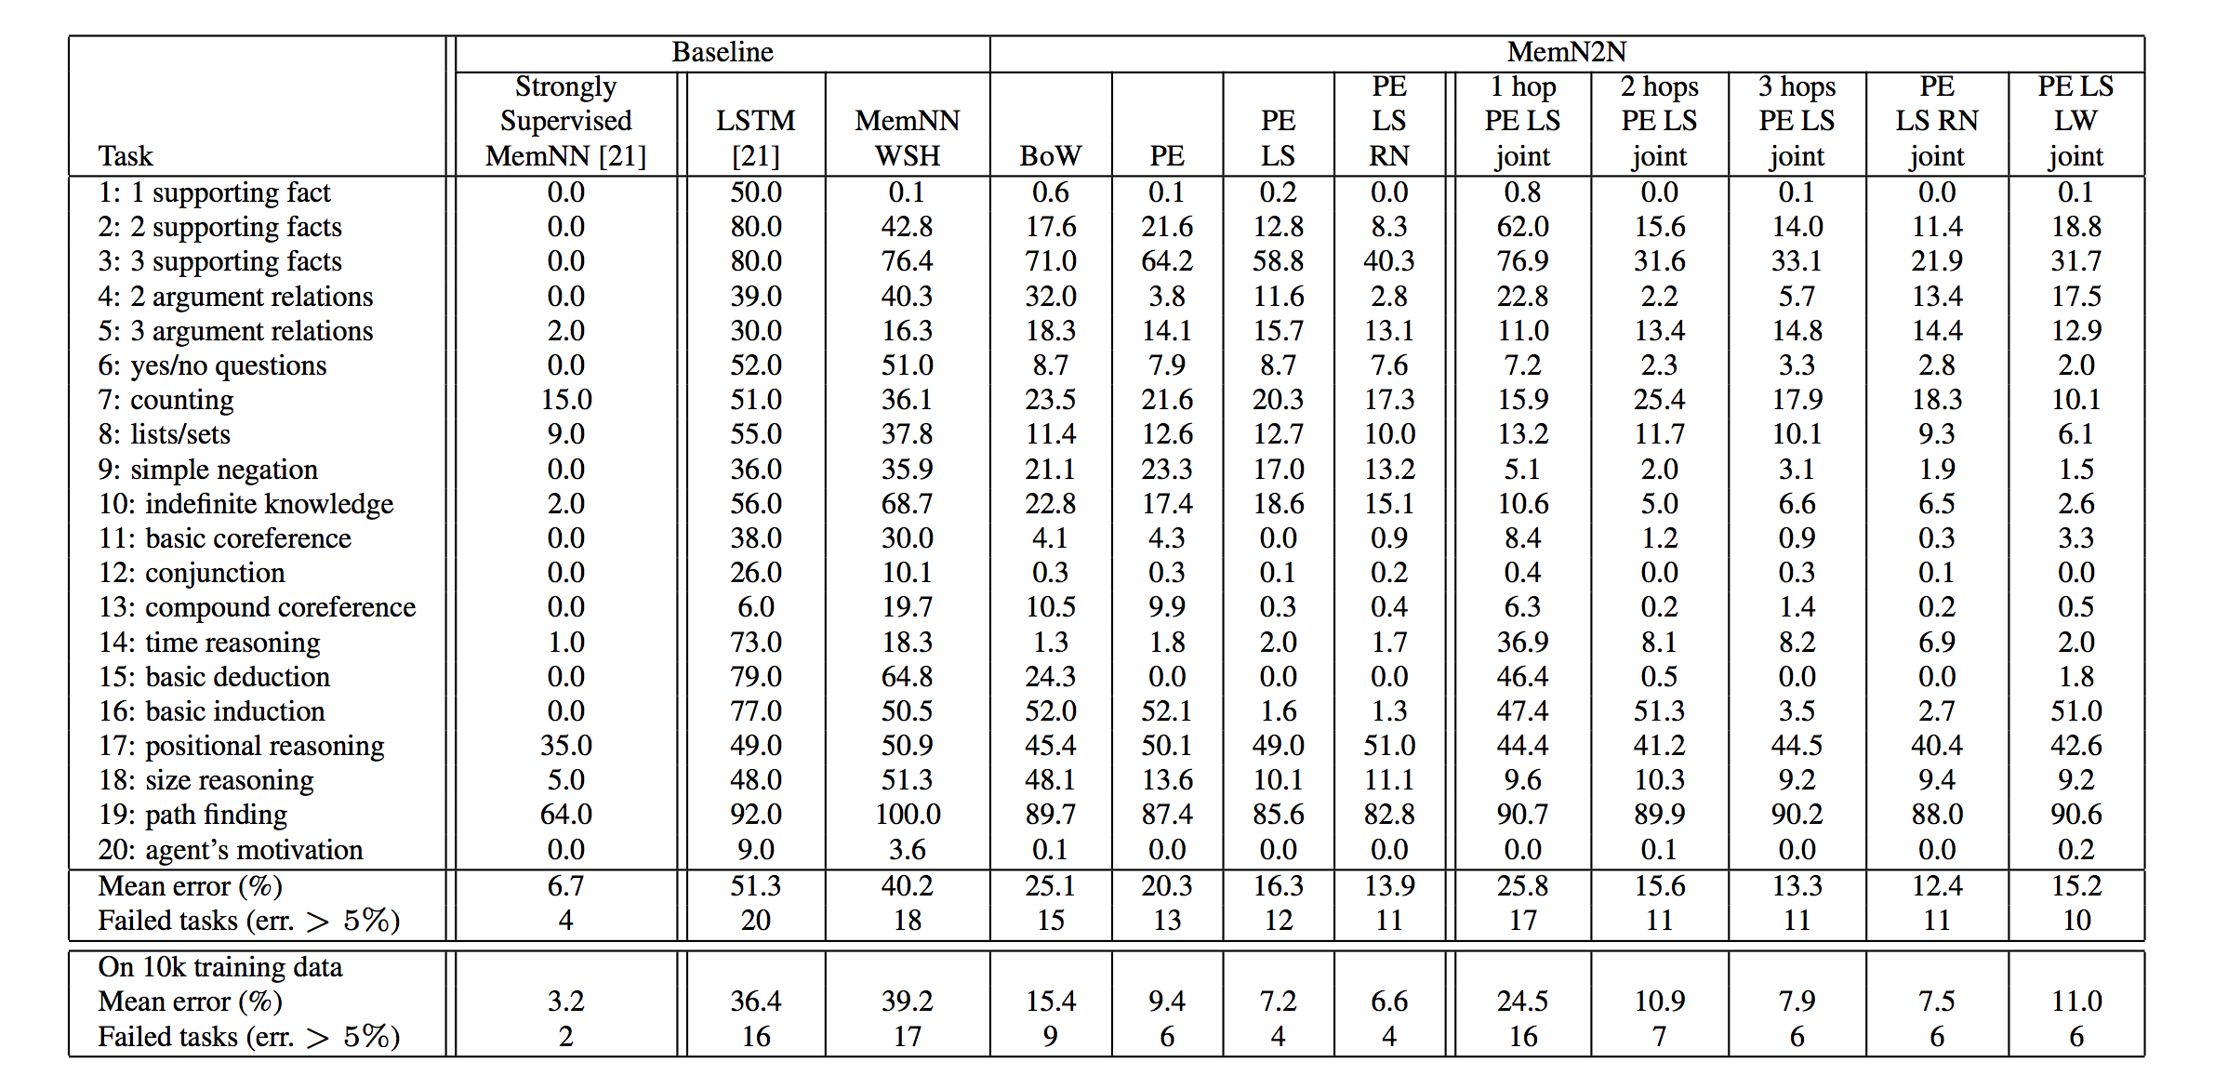
Experiment – Synthetic QA
Slide credit: Reference paper

Slide 27
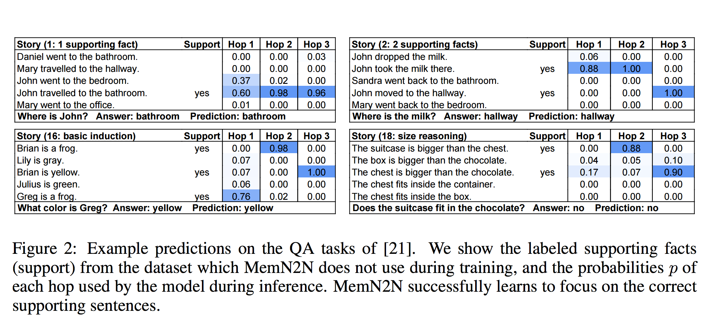
Experiment – Synthetic QA
Slide credit: Reference paper

Slide 28
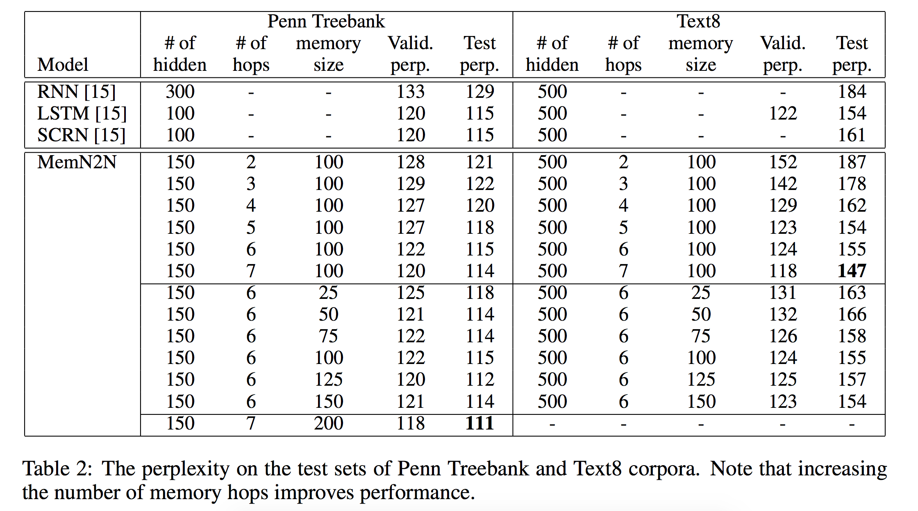
Experiment – Language Modeling
Slide credit: Reference paper

Slide 29
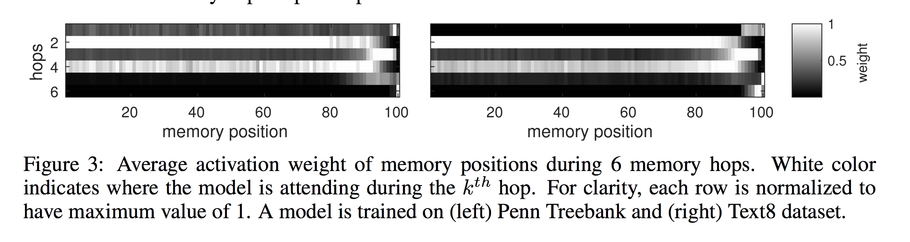
Experiment – Language Modeling
Slide credit: Reference paper

Slide 30
Problem?
Let’s see this sample in the dataset:
10 Sandra travelled to the hallway.
11 John went to the garden.
12 Where is Sandra? hallway 10
13 Sandra went back to the bathroom.
14 Sandra moved to the kitchen.
15 Where is Sandra? kitchen 14
1 Sandra travelled to the kitchen.
2 Sandra travelled to the hallway.
3 Where is Sandra? hallway 2
4 Mary went to the bathroom.
5 Sandra moved to the garden.
6 Where is Sandra? garden 5
Given Question: Where is Sandra? With so many fact in the memory, which one is the right one?

Slide 31
Large-scale Simple Question Answer with memory networks
Notion of “simple question answer”:
Knowledge bases contain facts as (subject, relationship, object)
Question only asking for object is called “simple question”, which
fetching a single fact from KB is sufficient to answer correctly.
Example:
Question: What do Jamaican people speak?
(jamaica, language_spoken, ?)
Question: Which forest is Fires Creek in?
(fires creek, containedby, nantahala national forest)
Slide credit: referenced paper

Slide 32
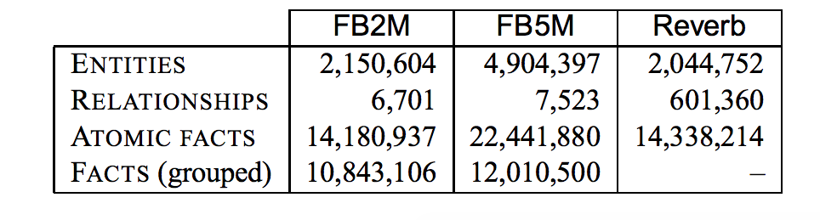
SimpleQuestion dataset
The dataset consist of 108, 442 questions by human annotators corresponding fact from FB2M.
Collect SimpleQuestions:
Shortlisting the set of facts from Freebase
Remove all facts for which more than threshold number of objects. (10) → remove uninformative question.
2. Select facts were sampled and deliver to human annotator
Fact with relationship appearing more frequently were given lower probabilities. → favor variablity
Slide credit: referenced paper

Slide 33
Memory Network Workflow
1: input module
Parse freebase, and store it (FB2M or FB5M)
Preprocessing Freebase
1: combine the same Subject and relation (list question)
2:
Reduce fact 14M→ 11M
Mediator node
Increase coverage 65→ 86
Slide credit: referenced paper

Slide 34
Memory Network Workflow
2: generalization module
Use pre-computed entity links. (Lin et al 2012)
Search freebase entities at least match one with reverb
3: output module
Approximate entity linking step generate small set of candidate fact
Supporting fact is the candidate fact most similar to question based on embedding model
Slide credit: referenced paper

Slide 35
Memory Network Workflow
4: Candidate generation
Generate possible n-gram for the question, only keep the n-gram which a are an alias of an entity.
Discard all n-grams are a subsequence of another n-gram, except if longer n-gram only differ by in, of, for, or the at beginning.
5: Scoring
Learn two embedding matrix W_{V} and W_{S}
Cosine similarity
6: Response Module
Returns the set of objects of the selected supporting fact.
Slide credit: referenced paper

Slide 36
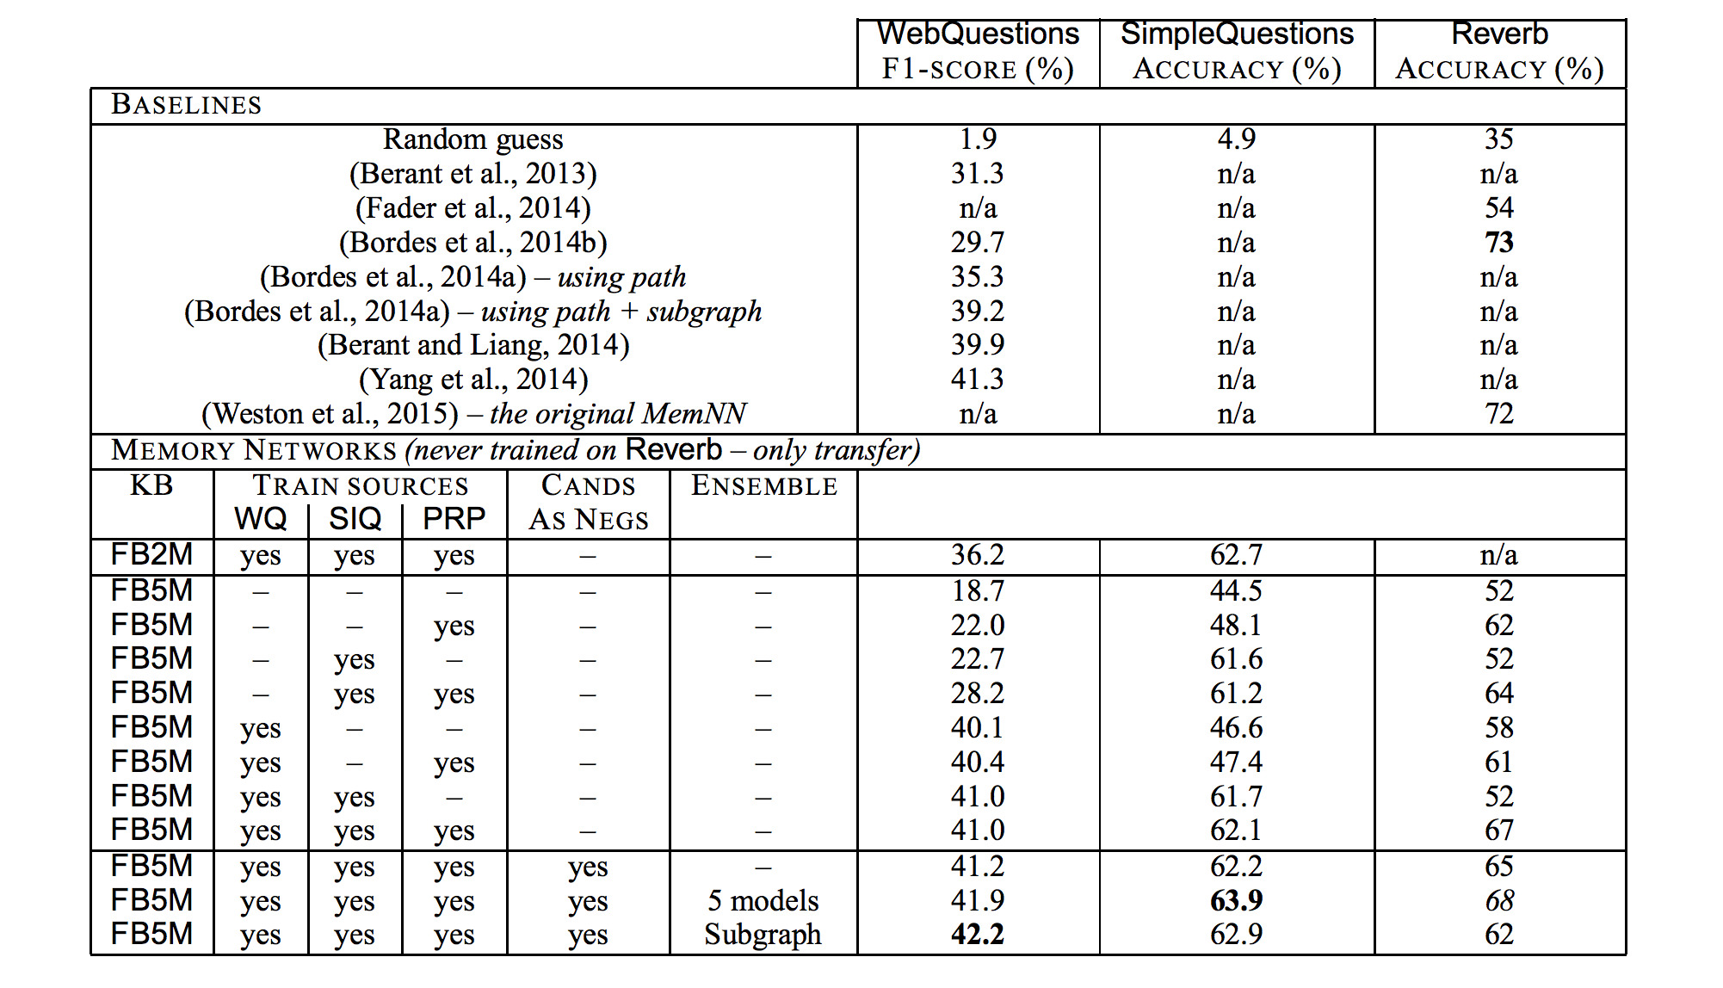
Results
Slide credit: referenced paper

Slide 37
Questions?

